Slide 1
Summaries
Why and How

Slide 2
Where do we see summaries?
Academic writing?
Journalistic writing?
Professional writing?
Public and personal writing?
Notes:
Academic writing
Essays summarize the ideas and arguments of others
Annotated bibliographies summarize research sources
Journalistic writing
News articles summarize events
Movie and book reviews summarize plots
Professional writing
Reports summarize events, progress, proposed ideas, problems, solutions (e.g. annual report)
Resumes and cover letters summarize your experience and skills
Employee performance reviews summarize accomplishments and areas for improvement
Public and personal writing
Social media posts can summarize an experience (e.g. restaurant review)
Blog posts can summarize the ideas and arguments of others

Slide 3
How to summarize
When you write a summary, you
Identify the thing you are summarizing
Reduce the original to its main ideas and key supporting points
Paraphrase the language of the original
Do not add your opinion or ideas

Slide 4
But first: who and why?
Before you begin, ask
Who is this summary for?
Why are you writing it?

Slide 5
Some possible scenarios
I am writing a summary of
an article because my professor told me to
a huge argument between a customer and my coworker that resulted in the customer’s cell phone being dropped in a fish tank
a blog I read about scheduling because I’d like my boss to consider implementing the ideas

Slide 6
“Because my professor told me to”
Purpose? To demonstrate knowledge and skills
What would your reader (i.e. the professor) look for in this summary? What is being evaluated?
Notes:
What is being evaluated in an academic summary?
Understanding of the article
Ability to separate main ideas from supporting details
Ability to paraphrase (put ideas into your own words)
Writing skills (organization of ideas, use of connecting words, grammar)

Slide 7

“Because a cell phone got dropped in a fish tank”
Purpose? To inform
What would your reader look for in this summary?
Notes:
What would your reader look for in this summary?
A summary of what happened without irrelevant details
Important information such as time, date, place, people involved
Objective description
A clear organizational pattern (for example, chronological)
An easy-to-read layout
Clear, concise writing

Slide 8
“Because I want my boss to read the article”
Purpose? To inform and persuade
What would your boss look for in this summary?
Notes:
Your goal:
To alert boss to the existence of the blog
To summarize the post for her (she’s busy!)
To persuade her that the blog post is worth reading / ideas are worth implementing
Your boss would want to know
Why you are summarizing this article for her
What ideas in the article are relevant to her
Where she can find out more if she wants to read the full article

Slide 9
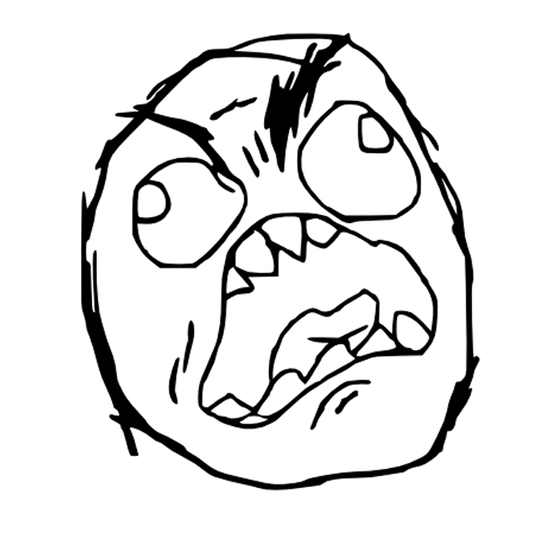
How to summarize an article
First of all…
accept that you’re going to have to read the article more than once.

Slide 10

Next: who and why?
Identifying who you are writing for and why will help you decide
What ideas to focus on
How to present the summary
What style to use
Notes:
Once you know who you are writing for and why you are summarizing, you can begin!

Slide 11
Six steps
Skim
Look at genre / overall structure
Identify main ideas / supporting ideas
Make a point-form outline
Write a draft
Revise

